Slide 1
From Ping to Pitch
AI Briefing Assistant for URO Advisor Pro
UnRiskOmega AG · START Global × Swiss AI Weeks 2026
Feature prototype inside a mocked URO Advisor Pro, not the live environment.
Notes:
SAY: A briefing assistant inside the tool the advisor already uses. It prepares the advisor for an unexpected client call.
SHOW: nothing yet.

Slide 2
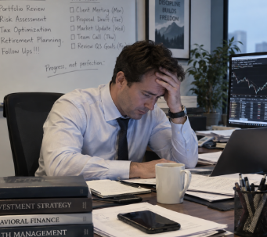
The advisor problem
Eight systems behind one client call
A client calls without warning. Preparation means eight systems.
The information exists, however distributed all over the place.
Building the storyline by hand: 20–30 minutes (the brief's figure, not ours)
Advisors rarely have that time before the call.
Performance
Allocation
Suitability
Rules
Proposals
Notes
News
CIO view
From Ping to Pitch · UnRiskOmega × START Global · Swiss AI Weeks 2026
2 / 11
Notes:
SAY: The brief names the problem. The information exists, but it sits in many systems.
SHOW: the mocked dashboard with the client list.
NOTE: the 20–30 minute baseline is the brief's figure, not our measurement.

Slide 3
Trigger and complete user flow
Advisor opens a client or portfolio in the mocked URO Advisor Pro
“Create briefing” is the only entry point, in both views (the client view and the portfolio view)
Seven stages run behind that click
Output: three sections (Recent Development, Portfolio Health Check, Outlook & Next Best Actions), four answers (what happened, the situation, what could come next, what to do), evidence for every claim
Follow-up Q&A and a one-pager reuse the same evidence as the briefing, no contradictions
Create briefing
1
Collect
2
Analyse
3
Rules
4
Market
5
Bank view
6
Actions
7
Compose
From Ping to Pitch · UnRiskOmega × START Global · Swiss AI Weeks 2026
3/ 11
Notes:
SAY: The trigger is a button where the advisor already is.
SHOW: click Create briefing on Mary Poppins (CASE-007) — live. Point at the running stages, then at the three sections and the trace buttons.

Slide 4

The 60-second briefing
Recent Development
Portfolio Health Check
Outlook & Next Best Actions
Four answers
What happened
The situation
What could come next
What to do
Every claim links to its data source; gaps are stated
Prioritised: 2–4 items that matter for this client (e.g. risk, concentration, recent performance, liquidity)
Short enough to read before picking up the phone
~210
~1 min
words per briefing
reading time
From Ping to Pitch · UnRiskOmega × START Global · Swiss AI Weeks 2026
4 / 11
Notes:
SAY: The briefing is a selection, not a summary of eight systems.
SHOW: scroll one briefing; hover a trace button; open the evidence rail.

Slide 5
Example briefing: Lena Vogt (SCEN-001)
Scenario from the brief: an unexpected call and a planned property purchase
62%
80%
62%
in ASML
in Information Technology
in EUR, against a CHF base
−11.90%
−16.51%
18.4%
Risk profile allows 7.5% volatility
over 12 months
over 3 months
portfolio volatility
Action #1 Secure liquidity. Do not lock money into illiquid assets before the property decision.
From Ping to Pitch · UnRiskOmega × START Global · Swiss AI Weeks 2026
5 / 11
Notes:
SAY: The key facts land on one page, in the order the conversation happens.
SHOW: open the SCEN-001 briefing and read the first two blocks aloud.

Slide 6
Data sources used: where the info about the client comes from
What the bank gave us
Provided by UnRiskOmega
Market news
Live
47
703
504
Live fetch, filtered to the client's holdings, cached.
client bundle: 1 package per client, holding everything known about them
Positions throughout all bundles
Securities throughout all bundles
Bank / CIO view
Mock
180
206
153
48'101
Curated UBS CIO Market Outlook 2026, declared mock in payload and UI.
suitability violations
proposals
client notes
fund mappings
Ex-custody statements
Imported
Added by us, because the brief omits them: market news (live) and the bank view (declared mock).
10 PDFs parsed to CHF 2'049'658.00, delta 0.00.
10 PDF statements from a custodian outside the bank, parsed into a portfolio
From Ping to Pitch · UnRiskOmega × START Global · Swiss AI Weeks 2026
6 / 11
Notes:
SAY: Two inputs the brief leaves out: news and the bank view. One is real, one is a declared mock.
SHOW: the provenance chips at the top of any briefing (Live · Simulated · Mock).
NOTE: news comes from public news feeds, filtered to the client's holdings.

Slide 7
How does the system decide what to tell the advisor, and can you trust it?
14 finding types decide what deserves attention
Each finding carries label, value, source and path
Risk contribution only: no cost basis, so no return attribution
Recommendations are ranked actions, each citing its findings
Deterministic rules today; the LLM renderer is the plug-in point
14
finding types
Allocation drift
Rules
Concentration
Risk
Liquidity
Notes
Tasks
From Ping to Pitch · UnRiskOmega × START Global · Swiss AI Weeks 2026
7 / 11
Notes:
SAY: The work is in selecting what matters and showing where each statement comes from. The rules are deterministic; the LLM renderer is the plug-in point.
SHOW: open the 'What should the advisor do?' answer and its action list on a client with a rule breach.

Slide 8
Technical architecture
Mocked URO Advisor Pro
Briefing API
Seven pipeline stages
BriefingFacts
Renderers
React + TypeScript
Python / FastAPI
collect to compose
one keystone document
EN and DE, same numbers
BriefingFacts is produced once and used by every renderer
Missing data is reported as a gap, not an error
Bilingual EN/DE with identical numbers and findings
From Ping to Pitch · UnRiskOmega × START Global · Swiss AI Weeks 2026
8 / 11
Notes:
SAY: One shared document feeds every output, so the briefing, the Q&A and the one-pager stay consistent.
SHOW: the stage list on the running briefing screen.

Slide 9
Mock data vs production integrations
Mock
Real
URO Advisor Pro chrome
47 synthetic clients
Bank/CIO view, declared in the payload
The instruments
Live market news
All portfolio mathematics
Production replaces each mock, one-for-one
Production adds
URO APIs · bank CRM · licensed market data
Approved news feeds · internal CIO publications · the bank's rule engine as a service
Nothing in the prototype touches the live URO environment.
From Ping to Pitch · UnRiskOmega × START Global · Swiss AI Weeks 2026
9 / 11
Notes:
SAY: Every mock is a seam we can name; production replaces each one.
SHOW: the mock badge on the bank-view block inside the briefing.

Slide 10
Bonus features completed
Ex-custody PDF import
Follow-up Q&A
A foreign portfolio behaves like a native one.
Grounded in the same evidence; says “unavailable” when it must.
CHF 2'049'658.00 · delta 0.00
Printable one-pager
Unseen-client drill
Client-ready sheet with the same traceability, made for the meeting.
A new client file uploads, validates and briefs, with no code change.
From Ping to Pitch · UnRiskOmega × START Global · Swiss AI Weeks 2026
10 / 11
Notes:
SAY: Four bonus features, all shown in the live demo.
SHOW: External banks panel → ex-custody report → KPIs; then the Q&A panel; then the one-pager; then the unseen-client import.

Slide 11
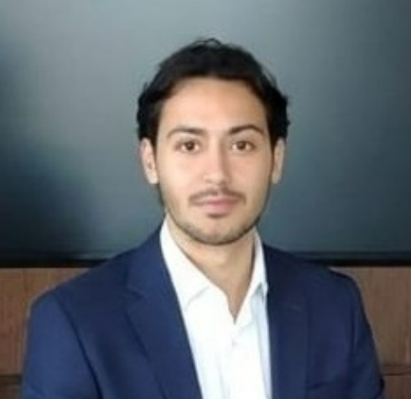
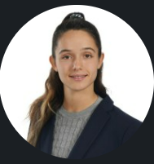
Team
Photo
Photo
Giray Unlu
Katrin Tosheva
focus: AI
girayn5@gmail.com
focus: Economics
Katrinalexandrova.tosheva @student.unisg.ch
FinSights Labs JKU Linz University of St. Gallen
From Ping to Pitch · UnRiskOmega × START Global · Swiss AI Weeks 2026
11/ 11
Notes:
SAY: [Introduce the team: names, roles, one line each.]
Placeholders: replace names, roles and photos before presenting.

